Slide 1
«Smart house technology»
Kharkiv National University
Report on the topic
Done by:
Yurii Bezruk,
KS-11 group

Slide 2
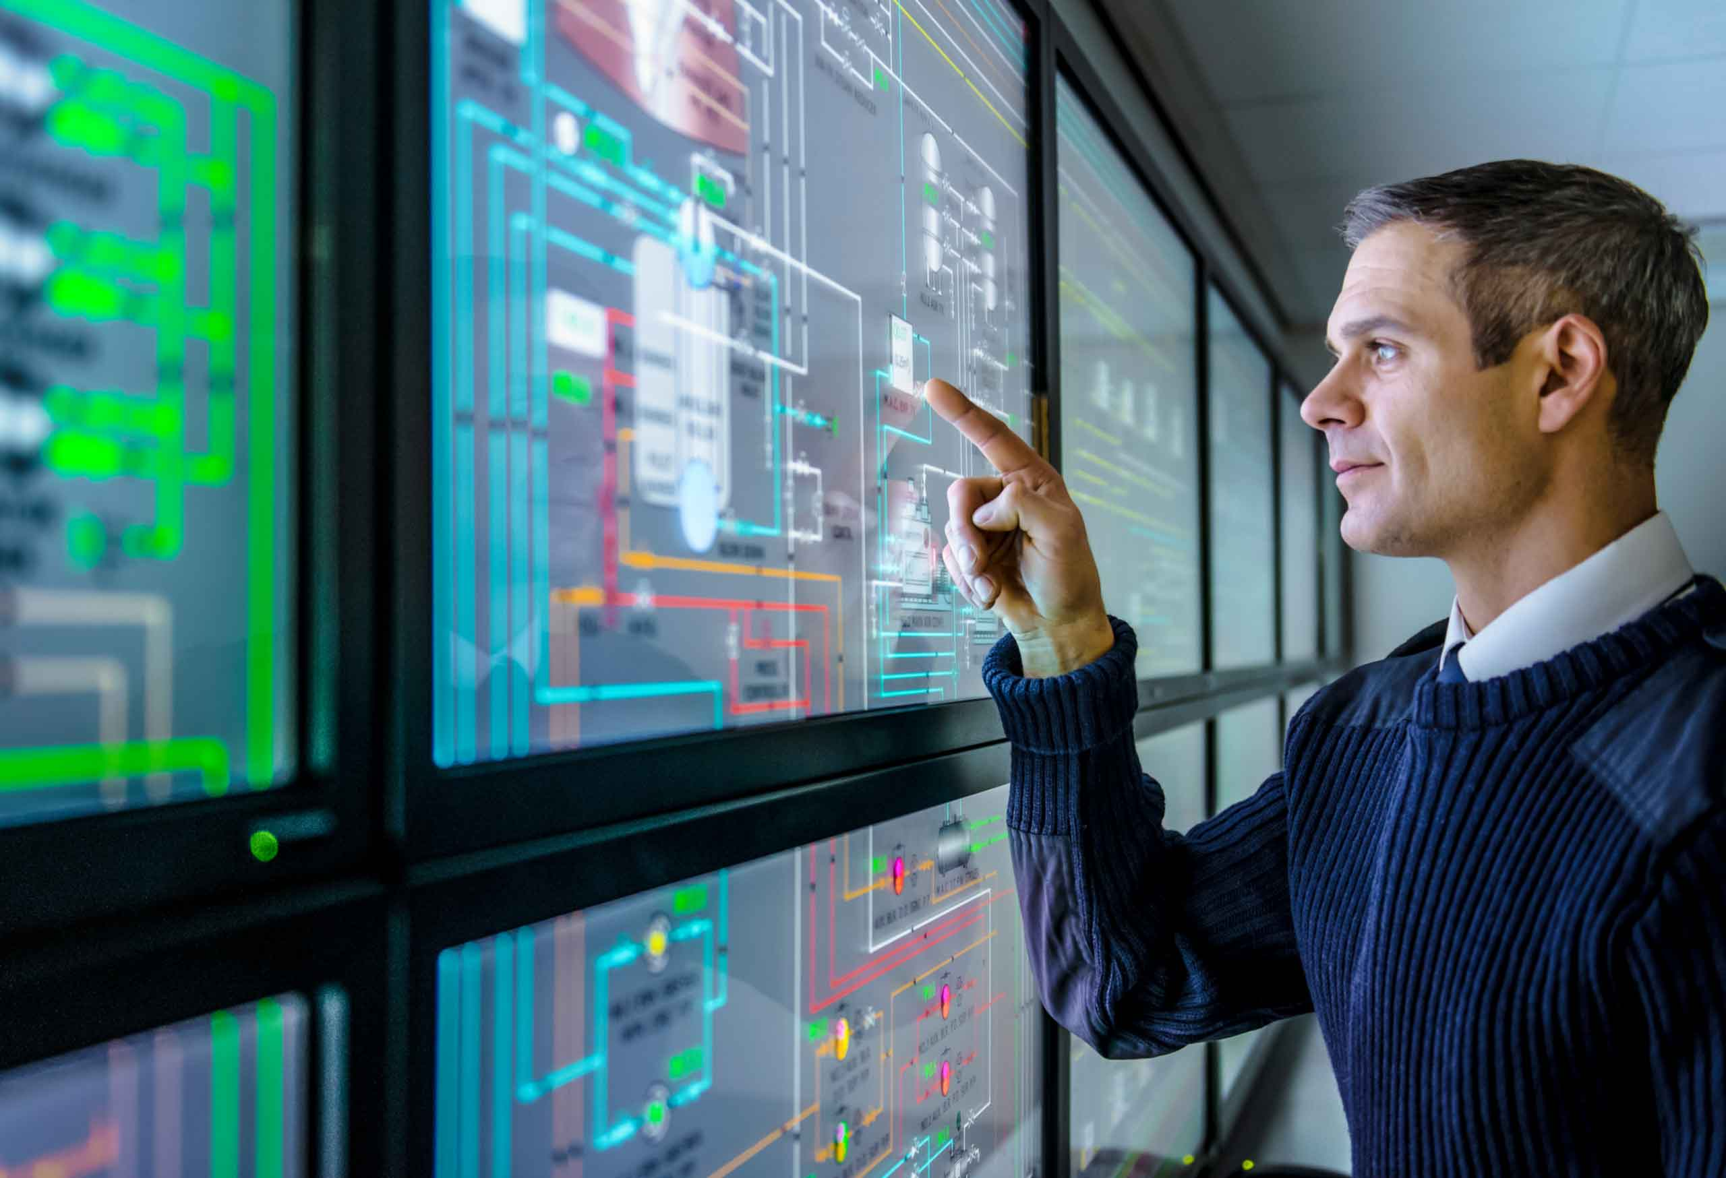

Modern technologies

Slide 3
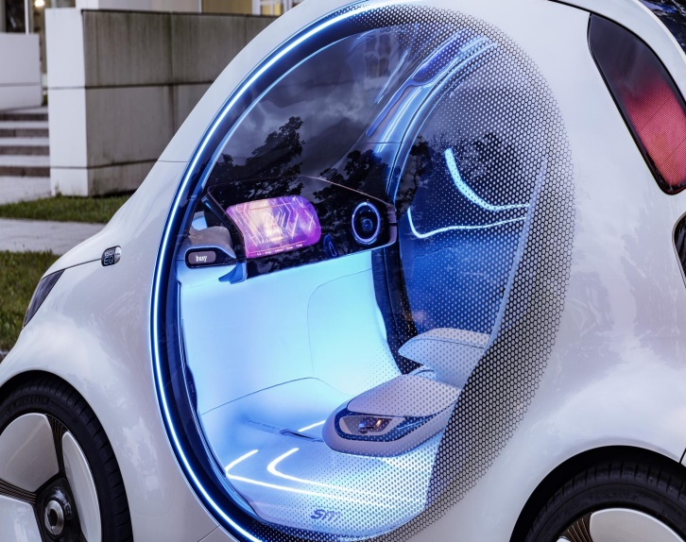
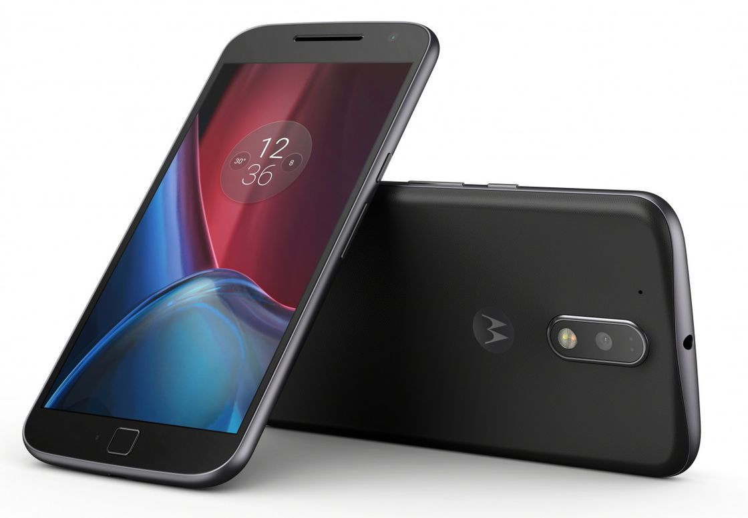
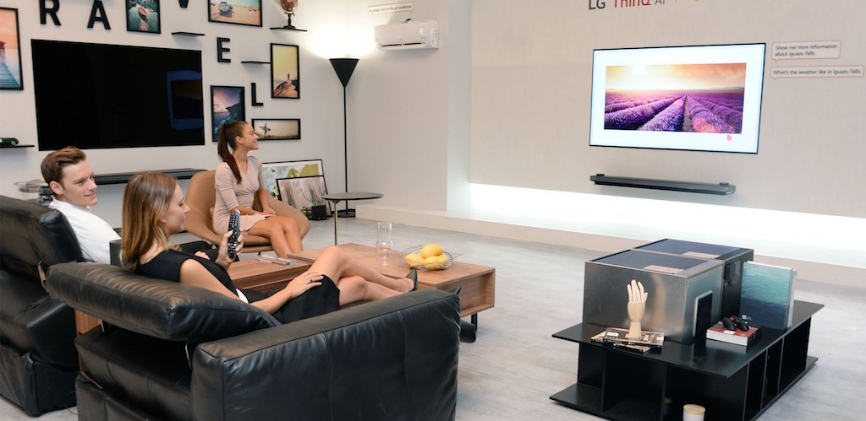
“Smart” features and things
“Smart” car
Smartphone
“Smart house”

Slide 4
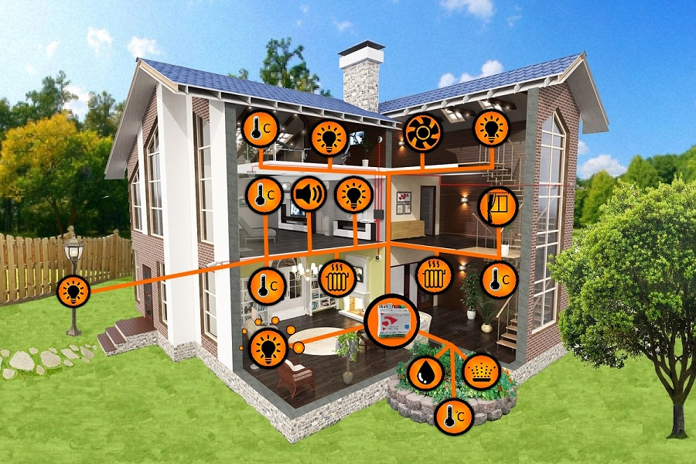
Life-supporting systems
Central computer controls all life-supporting systems, such as lightning, water system, heating system, air condition and others.
You can control it using audio or video equipment

Slide 5
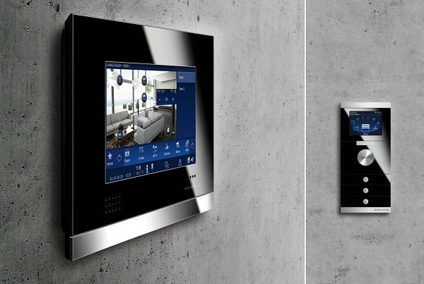
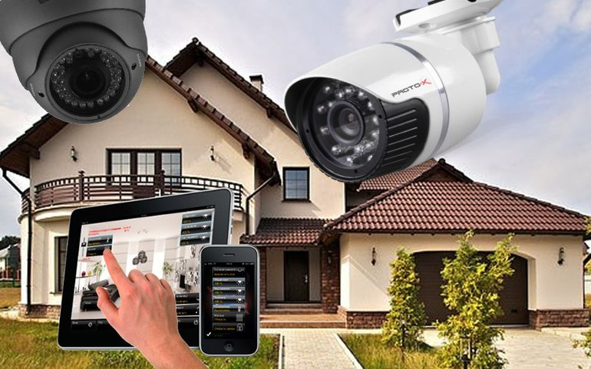
Safety system
If something is wrong with your house, you will be informed immediately.

Slide 6
Most wanted features of smart house

Slide 7
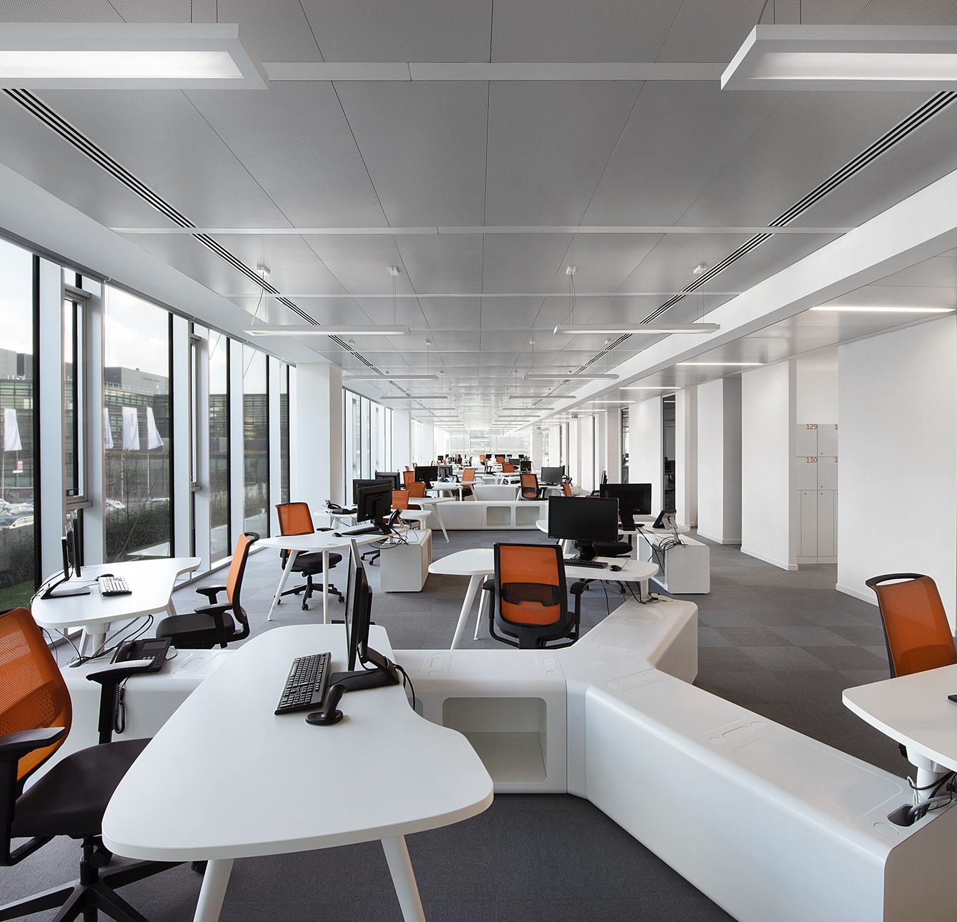
“Smart house” will be the usual thing!
There is the control of air-conditioning, heating systems, video monitoring in mane offices and commercial companies all over the world.

Slide 8
Thanks for your attention!

